Slide 1
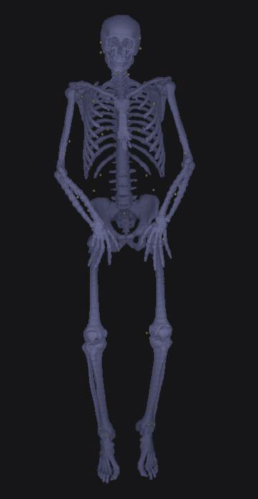
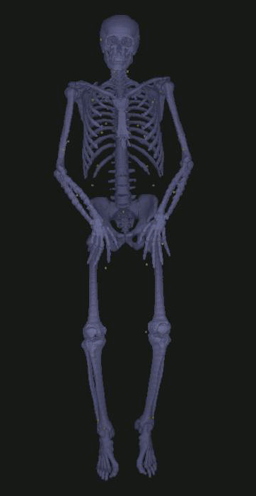
Virtual landmarks from
bone binary image
Virtual landmarks from
bone gray image

Slide 2
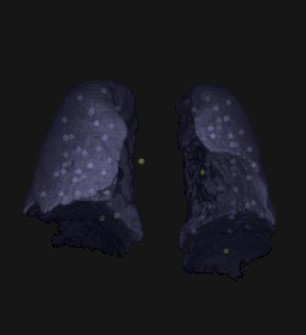
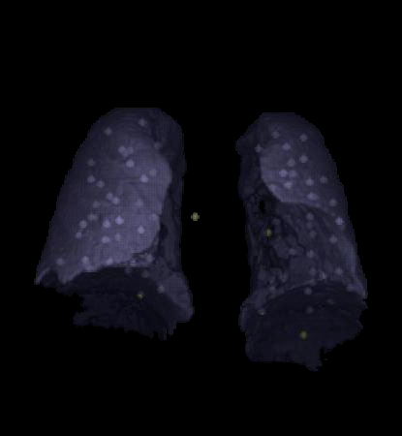
Virtual landmarks from
lung binary image
Virtual landmarks from
Lung gray image

